Slide 1
Myocardial Ischemia Detection from Slope of ECG ST Segment
Our main aim is to develop a program/code to detect myocardial
Ischemia with the help of ECG report,which would be computationally less complex and easy to implement in homecare ECG devices.
It has been observed that for the normal case, the ST segment(in pqrs complex)is at approximately the same level as the isoelectric line. However, it is found that for ischemia, the ST segments are clearly elevated with respect to the isoelectric level .
So, the proposed method measures slope of ST segment which must vary in case of ST changes.
We are using the European ST-T database ehich contains ECG signals with ST segment and T wave changes (Taddei, et al., 1992). The database contains ECG signals from ischemic patients where normal ECG sections and sudden ischemic episodes are annotated.

Slide 2
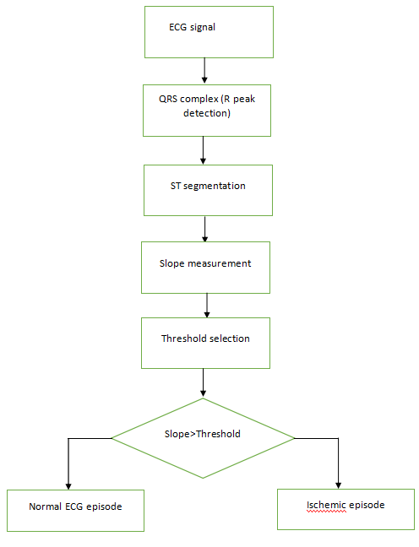
Steps to be followed for the detection of ST segment
QRS complex detection(R peak detection).
Finding of ST segment or ST segment detection.
Slope measurement.
Thresholding
Result and analysis.

Slide 3
ST segmentation
The duration of ST segment is usually 120ms.
The ECG signals used have a sampling frequency of 250 Hz. So the length equals to approximately 30 samples.
Experimentally it is observed that the ST segment starts at about 15 samples after the R peak. So the 30 samples of ST segment is extracted accordingly.

Slide 4
Algorithm for ST segment detection.
Step1: Start
Step 2: Locate the R Peak.
Step 3: Take the 15th sample after the R peak.
Step 4: Take approximately 30 sample after the 15th sample.
Step 5: Save these 30 sample as ST segment.
Step 6: End

Slide 5
Slope measurement
When elevation of ST segment is higher than 0.1 mV, it is called ST elevation.
In normal condition, the ST segment seldom elevates. If the ST segment is elevated, then the slope the ST segment creates with the isoelectric line will vary.
For a single ST segment, if A and B are the values of the last and first sample respectively, C is the number of samples in the ST segment then the slope can be defined as,
tan 𝜃 = 𝐴 − 𝐵/C
Similarly, slope of each ST segment of a portion of ECG signal is calculated and averaged to get an overall trend.
Thresholding: The thresholding of slope value to classify a portion of ECG as ischemic episode or normal ECG episode is done experimentally. Detailed process of this is discussed in the results analysis section.

Slide 6
Result and Analysis
The target of the proposed work is to examine whether slopes of ST segments of ischemic episode and normal ECG episode cluster in different groups.
The table below contains detailed information of the ECG signals used. From each of the five patient records episodes of normal ECG and ischemia is taken. Also the average slope of all the ST segments in that particular episode of ECG is calculated.
For finding a threshold value we have separated the classes into two, one for normal patient and another for ischemic patients.
Then the slope values of normal ECG episodes are sorted in ascending order and ischemic episodes in descending order. The tablebelow shows the sorted values of both the patient.

Slide 7
From the table, it can be observed that the two series intersects at around 0.34. So if a threshold is selected based on it then any value over 0.34 would be a detected as an ischemic episode.
The next step is to test the algorithms accuracy against threshold values at or around 0.34, which is listed in Table 3. The accuracy is calculated as
𝐴𝑐𝑐𝑢𝑟𝑎𝑐𝑦 = 𝑇𝑃 + TN /𝑇𝑃 + 𝐹𝑁 + 𝑇𝑁 + 𝐹𝑃 × 100
A correctly identified normal ECG episode is termed as True Negative (TN) and correctly identified ischemic episode is True Positive (TP). Incorrect identification of a normal ECG episode as an ischemic episode is False Positive (FP). Similarly, incorrect identification of an ischemic episode as a normal ECG episode is False Negative (FN).

